Slide 1
Object oriented analysis & design
CS3C015

Slide 2
UNIT- 1
Structure of Complex Systems, Object Oriented Development Methods, Characteristics of Objects, Fundamental Concepts of Object orientation, UML- Overview, RUP and its Phases

Slide 3
prerequisites
Software Engineering(SDLC)
Object Oriented Programming(OOP)

Slide 4
Object-oriented analysis and design
Object-oriented analysis and design (OOAD) is a popular technical
approach for
analyzing,
designing an application, system, or business
by applying the object oriented paradigm and
visual modeling throughout the development life cycles for better communication
and product quality.
Object-oriented programming (OOP) is a method
based on the concept of “objects",
which are data structures that contain data,
in the form of fields,
often known as attributes;
and code, in the form of procedures,
often known as methods.

Slide 5
Continued…
What is OOAD?- Object-oriented analysis and design (OOAD) is a software engineering approach that models a system as a group of interacting objects .
Analysis — understanding, finding and describing concepts in the problem domain.
Design — understanding and defining software solution/objects that represent the analysis concepts and will eventually be implemented in code.
OOAD - A software development approach that emphasizes a logical solution based on objects.

Slide 6
Object oriented analysis & design
Object-oriented analysis and design (OOAD) is a technical approach used in the analysis and design of an application or system through the application of the object-oriented paradigm and concepts including visual modeling.

Slide 7
Object oriented analysis & design
Is a way of thinking of problems using models organized around real world concepts.

Slide 8
Object oriented analysis & design
Object-oriented analysis and design (OOAD) is a software engineering approach that models a system as a group of interacting objects and by defining a rules of objects.

Slide 9
Software engineering
SOFTWARE
+
ENGIEERING

Slide 10
software
Software is more than just a program code. A program is an executable code, which serves some computational purpose.
Software is considered to be collection of executable programming code, associated libraries and documentations.
Software, when made for a specific requirement is called software product.

Slide 11
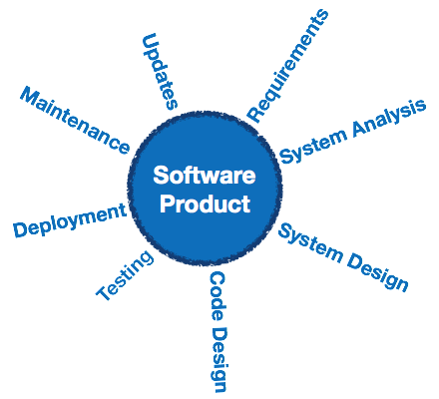
Engineering on the other hand, is all about developing products, using well-defined, scientific principles and methods.

Slide 12
Software engineering is an engineering branch associated with development of software product using well-defined scientific principles, methods and procedures.
The outcome of software engineering is an efficient and reliable software product.

Slide 13
Software process model(sdlc)
Software process model is an abstraction of the software development process. The models specify the stages and order of a process. So, think of this as a representation of the order of activities of the process and the sequence in which they are performed.
Goal:- The goal of a software process model is to provide guidance for controlling and coordinating the tasks to achieve the end product and objectives as effectively as possible.

Slide 14
Software process model(sdlc)
Need:-
software product can be developed systematically.
Helps common understanding of activities.
Helps to identify inconsistencies, redundancies and omissions.

Slide 15
Generic Process Model
Process:- A process is a series of steps involving activities, constraints and resources that produce an intended output of some kind.
Software Process:- is the related set of activities and processes that are involved in developing and evolving a software system
Any software process must include the following four activities:
Software specification.
Software design and implementation.
Software verification and validation.
Software evolution.

Slide 16
Communication
Phases of software model
Planning
Modeling
Construction
Deployment

Slide 17


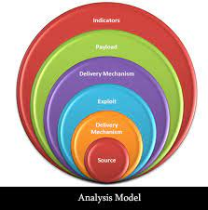


1. Communication: The software development starts with the communication between customer and developer. 2. Planning: It consists of complete estimation, scheduling for project development and tracking. 3. Modeling: Modeling consists of complete requirement analysis and the design of the project like algorithm, flowchart etc.
4. Construction: Construction consists of code generation and the testing part..
5. Deployment : Deployment step consists of delivering the product to the customer and take feedback from them.

Slide 18
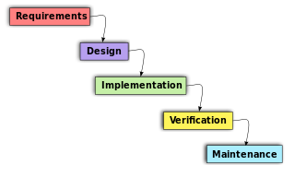
OOAD In The SDLC
The software life cycle is typically divided up into stages going from abstract descriptions of the problem to designs then to code and testing and finally to deployment.

Slide 19
Object-Oriented Analysis And Design (OOAD)
In analysis developers work with users and domain experts to define what the system is supposed to do. Implementation details are supposed to be mostly or totally ignored at this phase.
The goal of the analysis phase is to create a model of the system regardless of constraints such as appropriate technology. This is typically done via use cases and abstract definition of the most important objects using conceptual model.
The design phase refines the analysis model and applies the needed technology and other implementation constrains.
It focuses on describing the objects, their attributes, behavior, and interactions. The design model should have all the details required so that programmers can implement the design in code.
They’re best conducted in an iterative and incremental software methodologies. So, the activities of OOAD and the developed models aren’t done once, we will revisit and refine these steps continually.

Slide 20
Object-Oriented Analysis
In the object-oriented analysis, we …
Elicit requirements: Define what does the software need to do, and what’s the problem the software trying to solve.
Specify requirements: Describe the requirements, usually, using use cases (and scenarios) or user stories.
Conceptual model: Identify the important objects, refine them, and define their relationships and behavior and draw them in a simple diagram.

Slide 21
Object-Oriented Design
The analysis phase identifies the objects, their relationship, and behavior using the conceptual model (an abstract definition for the objects).
While in design phase, we describe these objects (by creating class diagram from conceptual diagram — usually mapping conceptual model to class diagram), their attributes, behavior, and interactions.
The input for object-oriented design is provided by the output of object-oriented analysis. But, analysis and design may occur in parallel, and the results of one activity can be used by the other.

Slide 22
In the object-oriented design, we …
Describe the classes and their relationships using class diagram.
Describe the interaction between the objects using sequence diagram.
Apply software design principles and design patterns.
A class diagram gives a visual representation of the classes you need. And here is where you get to be really specific about object-oriented principles like inheritance and polymorphism.
Describing the interactions between those objects lets you better understand the responsibilities of the different objects, the behaviors they need to have.

Slide 23
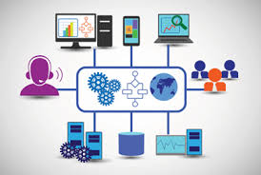
system
A group of things or parts that work together.
A system is a group of interacting or interrelated elements that act according to a set of rules to form a unified whole.
A system is a collection of elements or components that are organized for a common purpose.

Slide 24
Software systems
Software systems are not any different from other systems with respect to these characteristics. Thus, they are also embedded within some operational environment, and perform operations which are clearly defined and distinguished from the operations of other systems in this environment
Example. Library management system.
College information Management System
E-Learning Portal

Slide 25
complexity
Complexity depends on the number of the components embedded in them as well as the relationships and the interactions between these components which carry;
• Impossible for humans to comprehend fully
• Difficult to document and test
• Potentially inconsistent or incomplete
• Subject to change
• No fundamental laws to explain phenomena and approaches

Slide 26
Complexity
The larger the number of components and relationships between them, higher will be the complexity of the overall system.
Grady Booch
The function of good software is to make the complex appear to be simple.
Simple-
Largely forgettable applications
Very limited purpose
Afford to throw them away

Slide 27
The Structure of Complex systems:
Examples of Complex Systems:
The Structure of a Personal Computer
The Structure of Plants and Animals
The Structure of Matter
The Structure of Social Institutions

Slide 28
Personal Computer

Slide 29
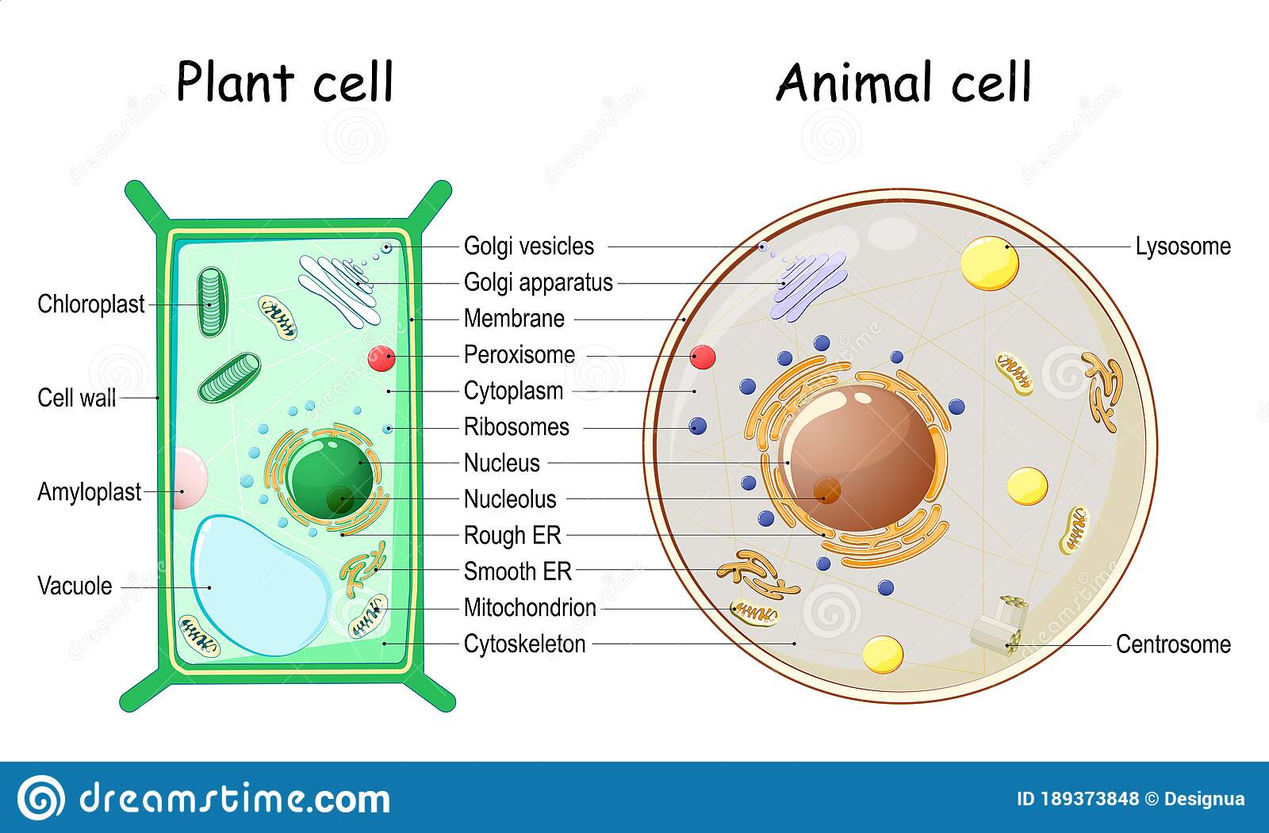
The Structure of Plants and Animals

Slide 30
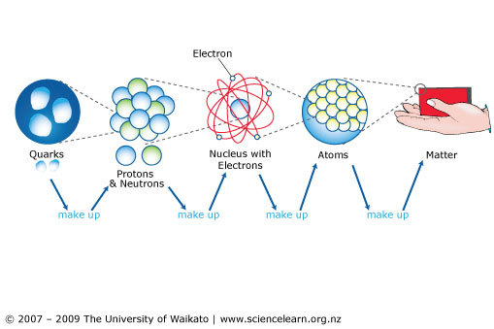
The Structure of matter :

Slide 31
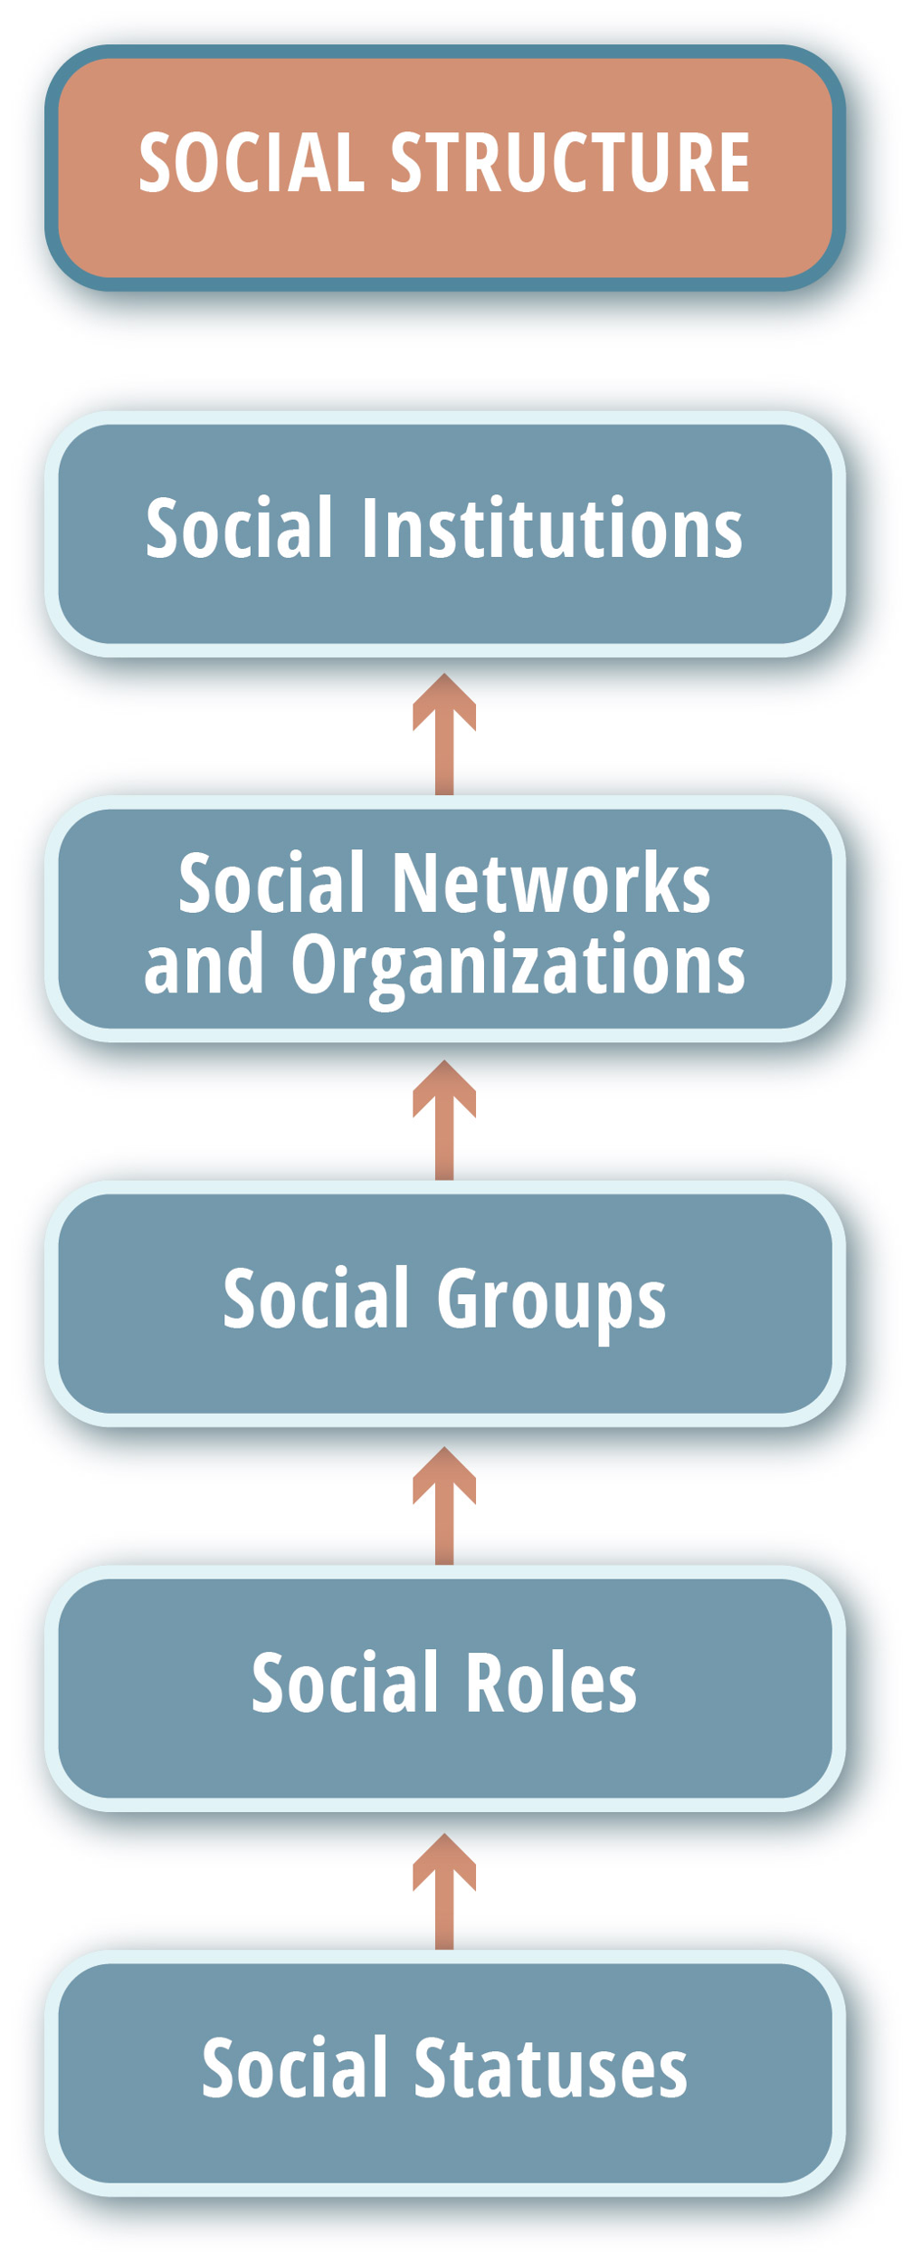
The Structure of social institutions:

Slide 32
Properties' of systems
Simple Systems
Complex Systems

Slide 33
Why Software Is Inherently Complex
The complexity of problem domain
The difficulty of managing the development process
The flexibility possible through software
The problem of characterizing the behavior of systems.

Slide 34
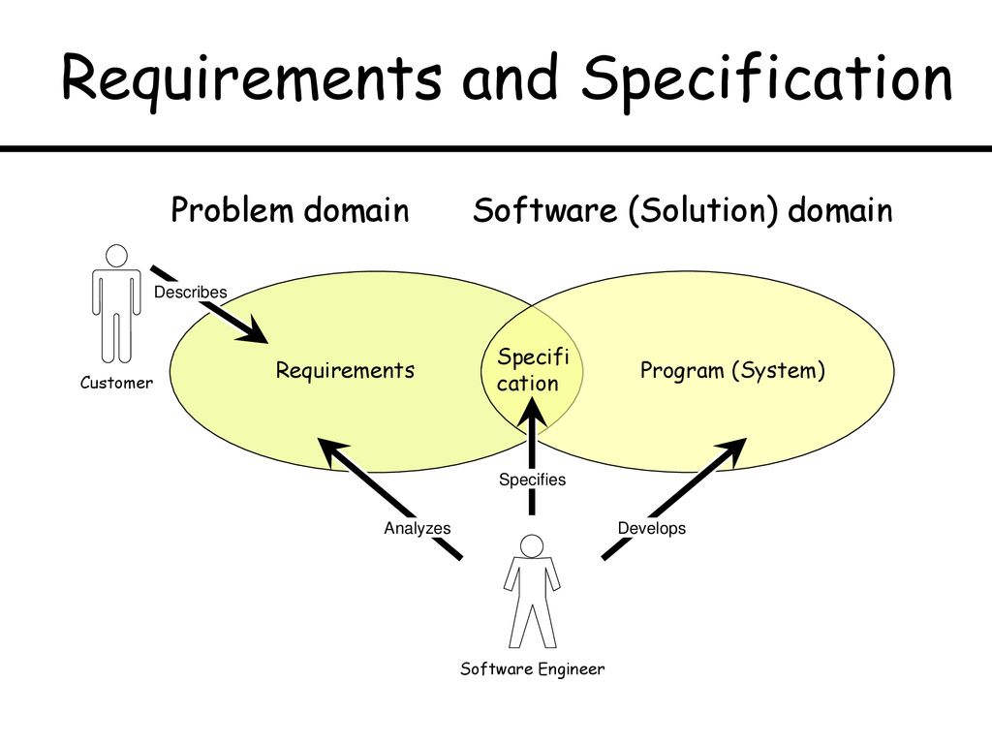
Why Software Is Inherently Complex
The complexity of problem domain
Complex Requirement
Decay of System
Example:
Multi engine aircraft
Cellular Phone

Slide 35

Why Software Is Inherently Complex
2. The difficulty of managing the development process
Management Problems
Need of Simplicity

Slide 36
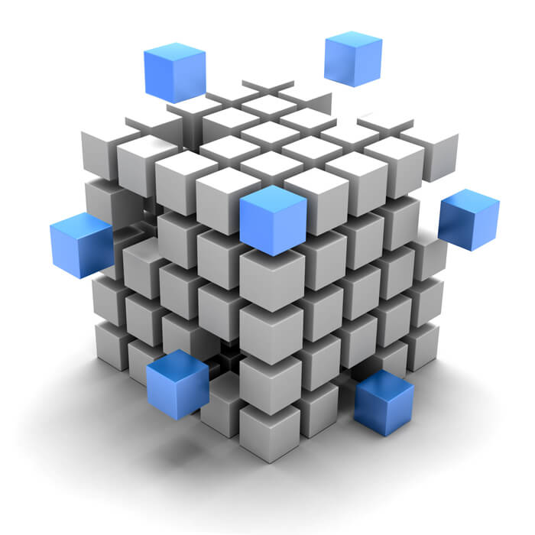
Why Software Is Inherently Complex
3. The flexibility possible through software.
Developers develop system components themselves rather than purchasing them from somewhere

Slide 37
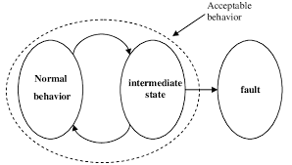
Why Software Is Inherently Complex
4. The problem of characterizing the behavior of systems.
Numerous possible states
Difficult to express all states

Slide 38
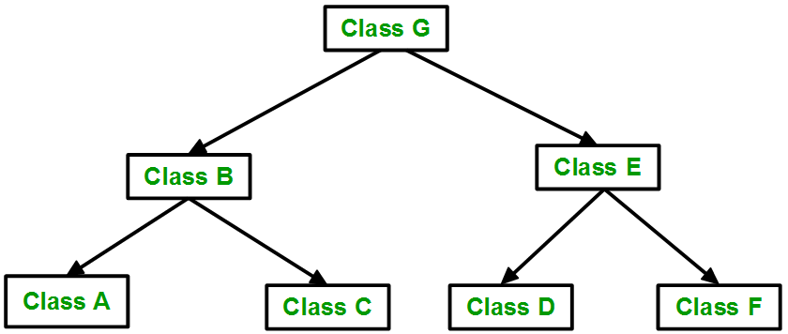
Attributes of Complex system
Hierarchical and interacting subsystems.
A complex system is composed of interrelated subsystems that have in turn their own subsystems and so on until some lowest level of elementary components is reached.

Slide 39
Attributes of Complex system
2. Arbitrary determination of primitive components. The choice of what components in a system are primitive is relatively arbitrary and is largely up to the discretion of the observer of the system.

Slide 40
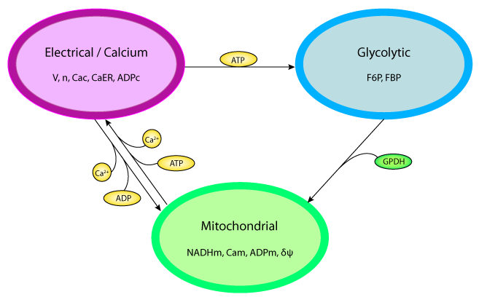
Attributes of Complex system
3. Stronger intra-component than inter components: Intra component linkages are generally stronger than inter component linkages. This fact has the effect of separating the high-frequency dynamics of the components—involving the internal structure of the components.

Slide 41
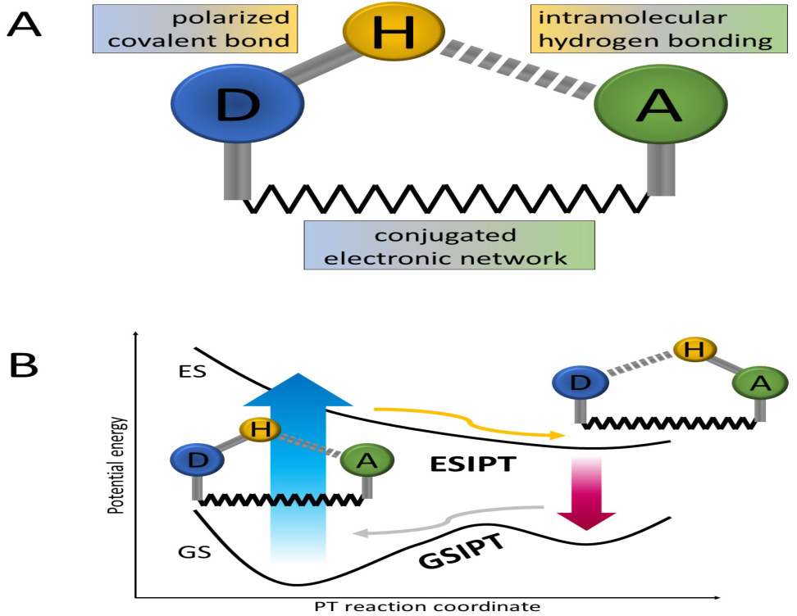
Attributes of Complex system
4. Combine and arrange common rearranging subsystems
Hierarchic systems are usually composed of only a few different kinds of subsystems in various combinations and arrangements.

Slide 42
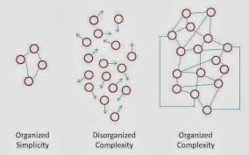
Attributes of Complex system
5. Evolution from simple to complex system.
A complex system that works is invariably found to have evolved from a simple system that worked.... A complex system designed from scratch never works and cannot be patched up to make it work., beginning with a working simple system.

Slide 43
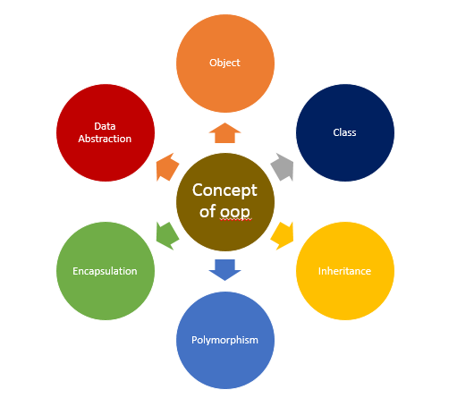
Basic concepts of oops

Slide 44
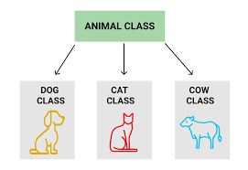
Basic concepts of oop
1. Class- Combination of data & function.
Eg- Fruit, Animal and Employee etc.

Slide 45
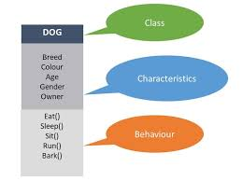
Basic concepts of oop
2. . Object:- Run time entity of class.
Eg- Mango, Dog and Manager etc

Slide 46
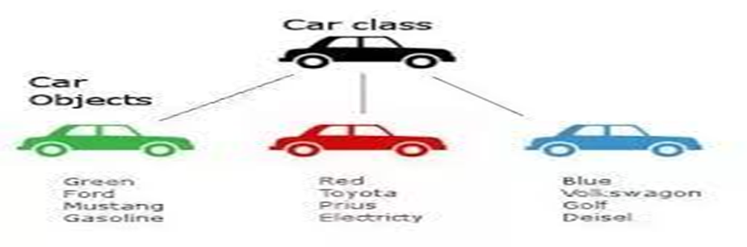
Class and object

Slide 47
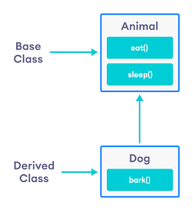
Basic concepts of oop
3. Inheritance :- Acquires the properties of parent.
Eg- Passing of physical or mental characteristics from one generation to another.

Slide 48
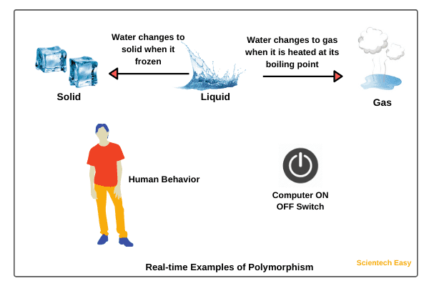
Basic concepts of oop
4. Polymorphism: one name many form.
Eg- addition (two,three or five values)

Slide 49
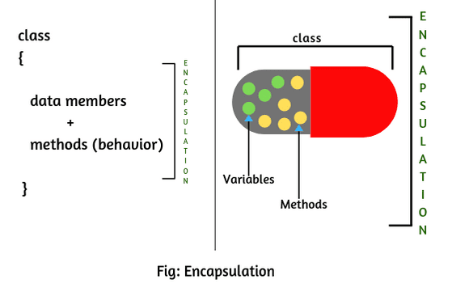
Basic concepts of oop
5. Data Encapsulation: Putting together.
Eg- company, college and Bus etc.

Slide 50
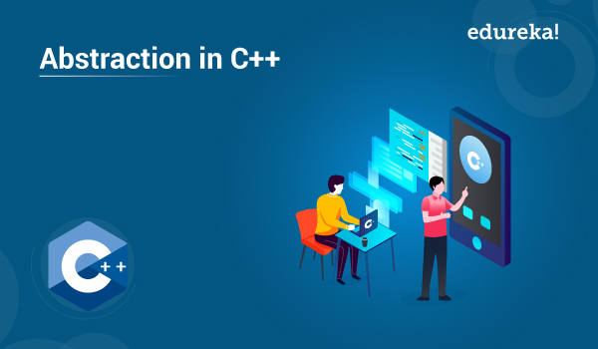
Basic concepts of oop
6. Data Abstraction: Process of hiding details from user.
Eg- sending SMS.

